Slide 1
Lab 5: Visual and Audio Display
CS341 Spring ‘21

Slide 2
Today Lab:
Interface with a Liquid Crystal Display
Fix starter code so message repeatedly scrolls across display
Play noise on a piezo speaker

Slide 3
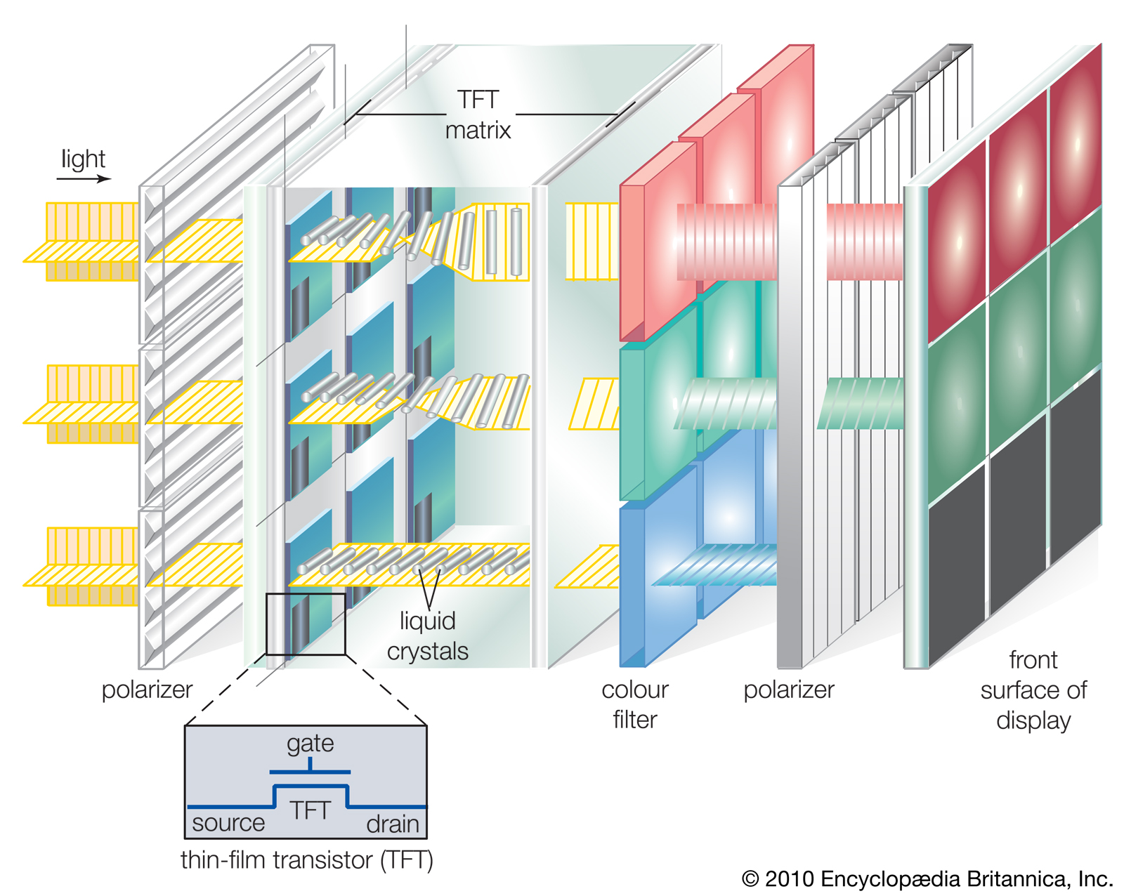
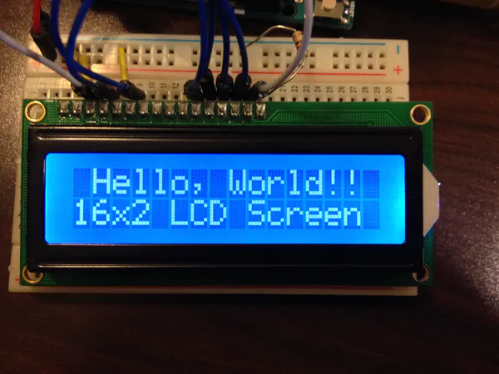
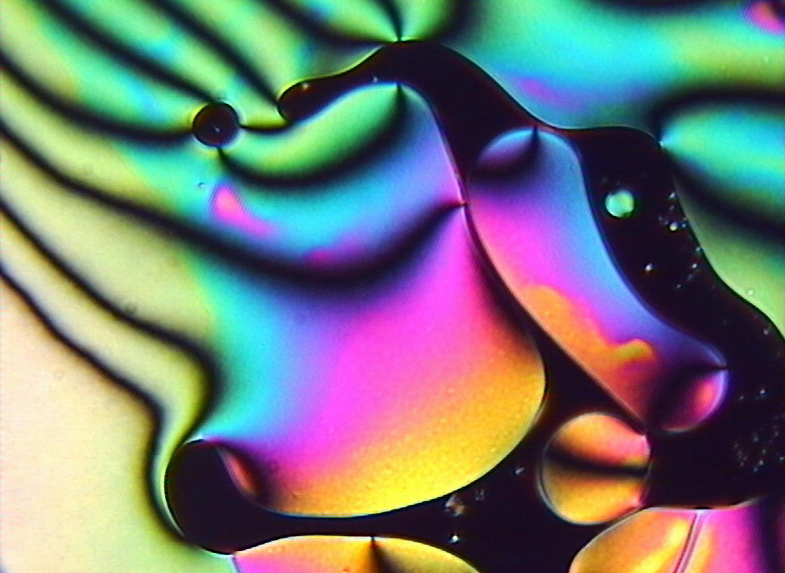
Components of Today: Liquid Crystal Display
Pixels controlled by input from device, such as arduino through it’s microprocessor or a display processor though its CPU (case for an LCD monitor).
Pixels are switched on and off electronically by using liquid crystals to rotate polarized light
Liquid crystals is a substance that goes through substates in between solid and liquid
Each pixel consist of 2 polarizing glass filter in front and behind a tiny globs of liquid crystal.
A tiny resistor switches the pixel on and off. This controls the state of the liquid. When more solid, light flows through.

Slide 4
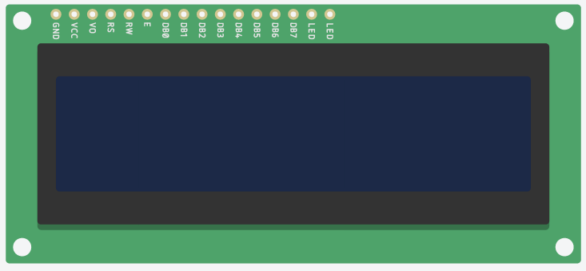
LCD pins
Takes digital input/parallel communication
We use it in 4 bit mode(4 wires to read and write).
Register Selection
Display Contrast
Data mode
Clock
Reading & Writing
Brightness (2 pins)
Power
Ground

Slide 5
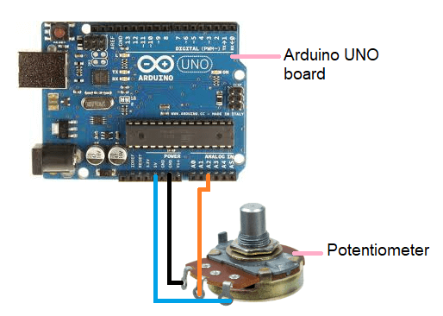

Components of Today:Potentiometer
Variable resistor
Allows us to control the resistance
In this lab, we use it to control the contrast on the LCD
Communicates with analog input
Different voltages are read and a range of outputs can be deduced
As opposed to digital input where its either 0v or 5v.
Instead of connecting the output for the arduino to read like here, we will connect it the the LCD

Slide 6
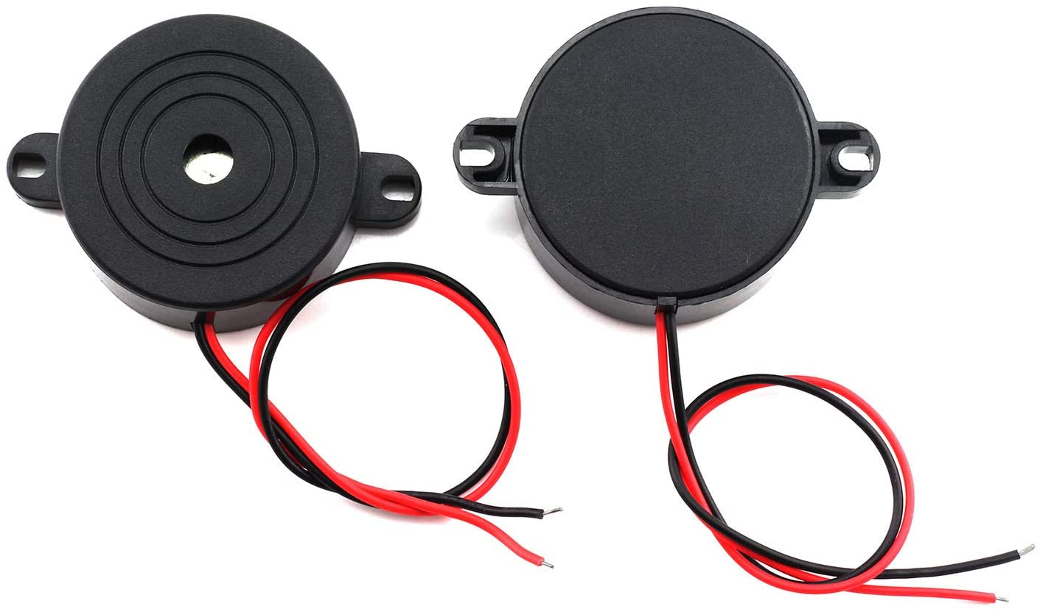

Components of Today: Piezo Speaker
Old Fashioned Speaker
Can use analog or digital input (case today).

Slide 7
What you’ll do:
Complete the circuit
Implement a circular buffer. Everytime loop() runs, print section of full text
“Welcome CS341 Students! ” Then you show:
“elcome CS341 Students! W”. Then you show:
“lcome CS341 Students! We” and so on.

